Slide 1
Clustering Kansas City by Postal Region
Created By: brandon Lombardino
Created date: 05/12/2020

Slide 2
Introduction
Business Problem: Where should I open a coffee shop in Kansas City?
Strengths:
Building a strong community relationship
Customer Service
Weaknesses:
Higher prices than most chain stores
Lack of innovative products

Slide 3
Data and Sources
Data Required:
Kansas City postal codes copied from the internet
Coordinates associated with postal codes manually inputted from the internet
Maps from folium package
Nearby venue data from Foursquare

Slide 4
Collecting the Data
Postal codes with corresponding coordinates are collected manually onto an Excel File
Data stored on Excel File is transformed into a csv
The csv is imported into Jupyter Notebooks using the Pandas module through Python
Geocoder is used to find the coordinate for Kansas City
A developer account on Foursquare is required to obtain venue data
Limited to 500 venues within a 1,000-meter radius of the city coordinates

Slide 5
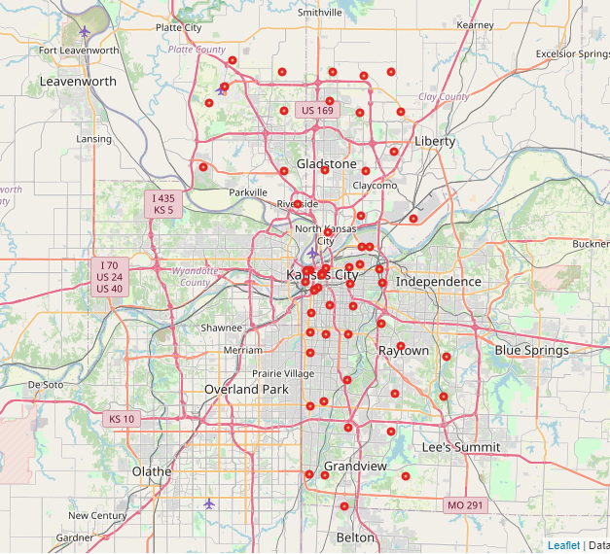
Mapping the Postal Codes
Coordinates are used with folium to map out the region

Slide 6
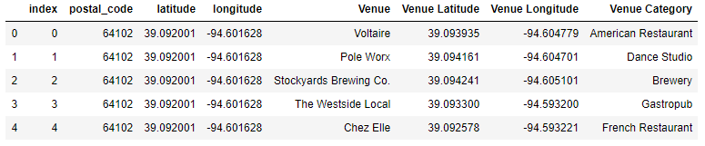
Consolidating Data
Postal Code data from the csv is merged with venue data from Foursquare to create a new dataset

Slide 7
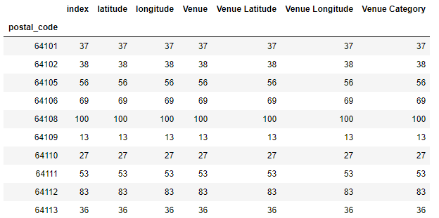
Number of Venues by Postal Code
Postal codes with less than 10 venues are dropped for the model

Slide 8
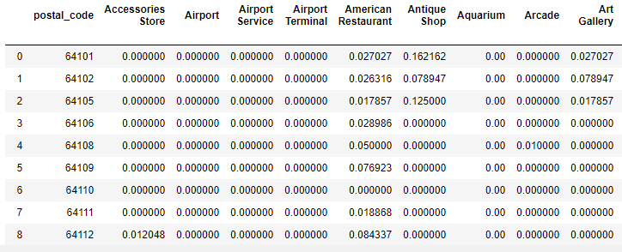
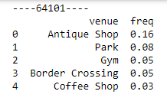
Mean of Frequency of Occurrence of Each Category

Slide 9
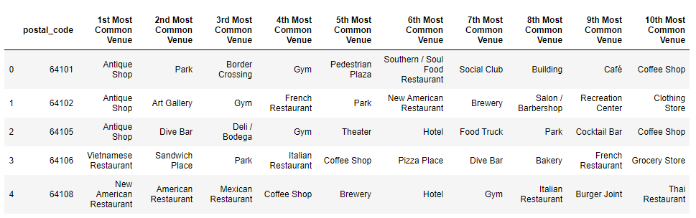
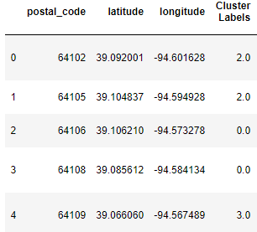
Clustering
The cluster model is based on the top 10 most common venues for each postal code.
The model separates each postal region by assigning them to one of 5 clusters

Slide 10
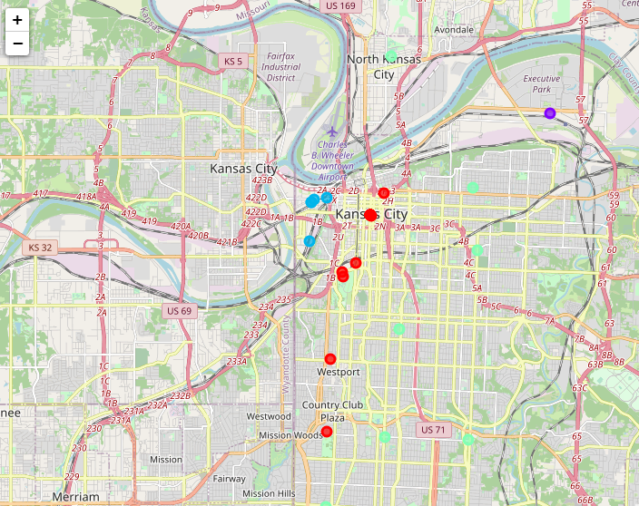
K-Means Clustering Results Mapped

Slide 11
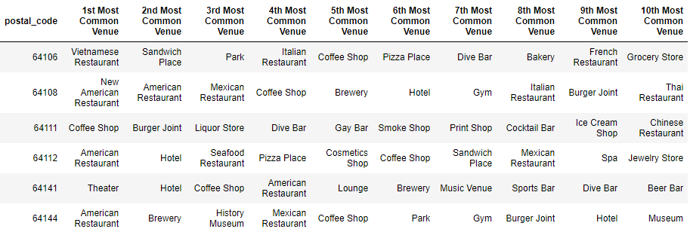
Cluster 1 – City Centre
Represented on the map in red
Defined by different types of bars and entertainment venues
Caters to nightlife and tourists

Slide 12
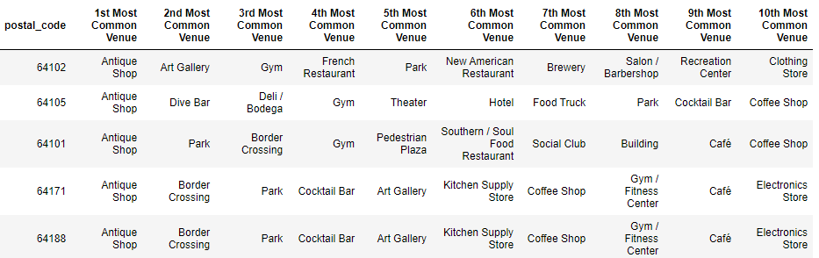
Cluster 2 – Industrial Oldtown
Represented on the map in blue
Defined by antique shops, border crossings, and parks
Caters to the old town and blue-collar community

Slide 13
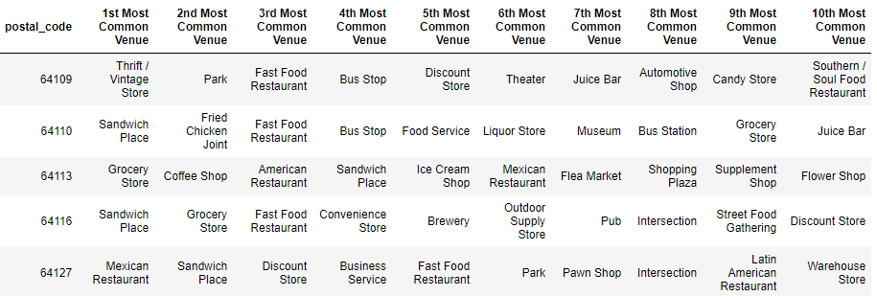
Cluster 3 - Suburbs
Represented on the map in green
Defined by restaurants and shopping centers
Caters to residents who value space and quiet over community and entertainment

Slide 14
Recommendations
Cluster 2 or Industrial Oldtown is best suited for a new coffee shop given the strengths and weaknesses of the business owner
Industrial Oldtown residents strongly support local shops over national chains
Industrial Oldtown has substantial foot traffic given the number of resident since many blue-collar workers arrive from outside the neighborhood to work at one of the many industrial facilities
Postal Area 64109 or locally known as south West Bottoms is the best region within the cluster because of the lack of existing coffee venues to compete with

